Slide 1
Boolean Network Models for Transcriptional Regulation
Alissa, Aleisha, Aaron

Slide 2
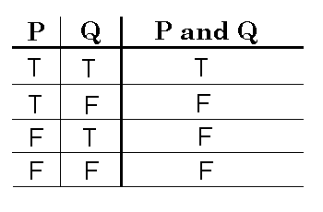
Boolean Network Models:
Description: ______________
-Creates a model based on condition statements/truth tables.
- EX: (Example of truth table)

Slide 3

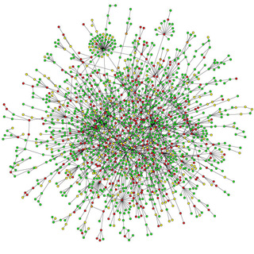
Applications
Cancer research
Signaling network research
In silico models of potential knock out effects
Help run simulations to determine new investigatory pathways

Slide 4
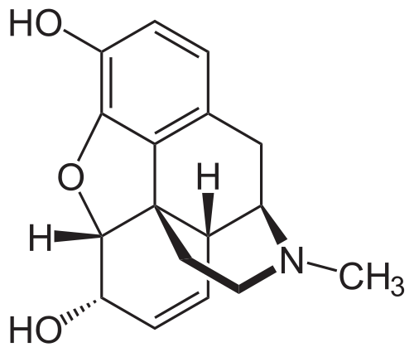
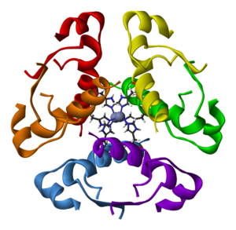
Genetically Modified E. coli:
Medical Modifications
Creates medicines such as insulin, opiates, and vaccines.
Biotechnology Modifications
Use of biotechnology to produce medicine from bacteria

Slide 5

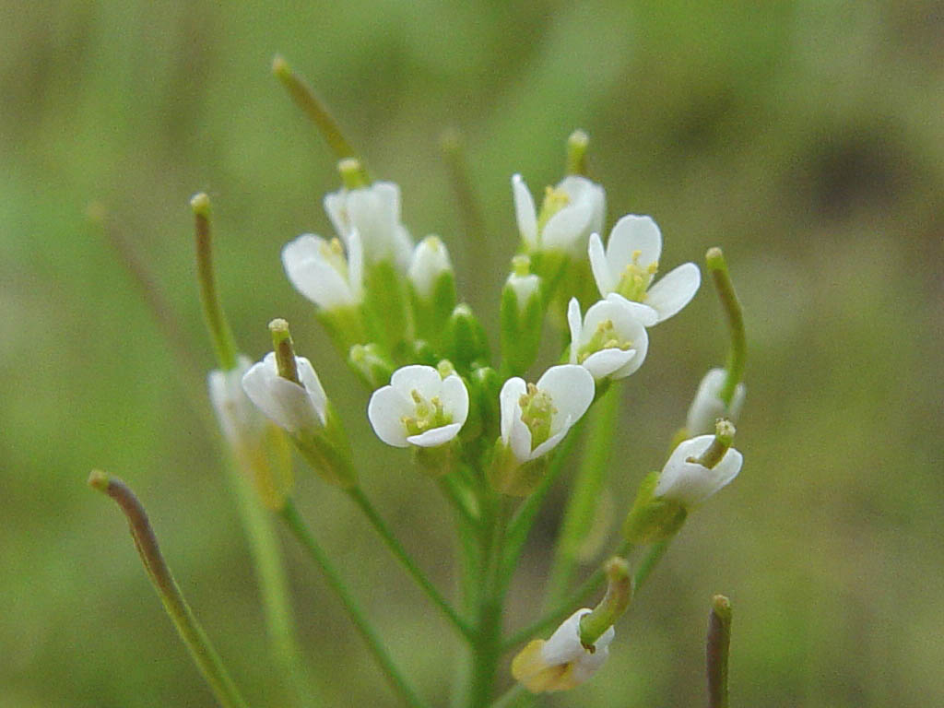
Our pathway: E. coli transgene opiate synthesis
Discovered by Bioengineers at Kyoto University:
Performed modifications by splicing genes from other bacteria.
Enzymes from Opium poppies and genes from other Bacteria Spliced into E. coli:
Coptis Japonica(Opium poppies) – Enzymes added from this plant.
Arabidopsis(Opium poppies) – Enzymes added from this plant.

Slide 6
Pathway in plants:

Slide 7
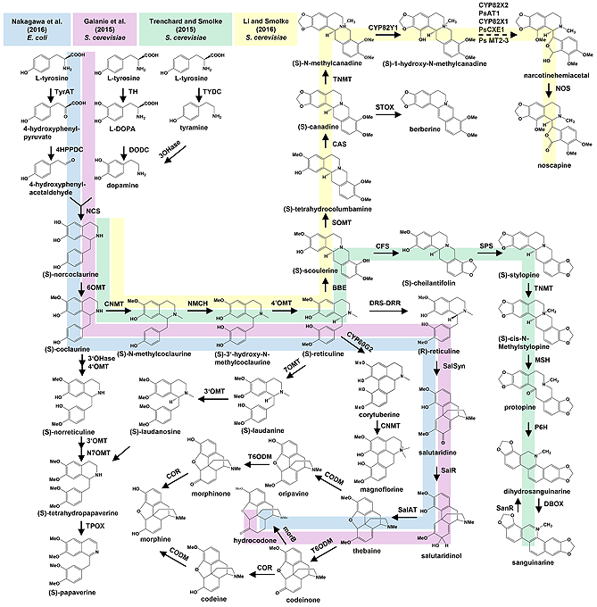
Pathway in Soandso et al.’s work:

Slide 8
Our program:
A simplistic Boolean network modeler, able to fulfill (#) goals:
Generate Boolean Network graphs
Allow for 1 or 0 state models of a given pathway (in our case, a metabolic pathway) by the user entering nodes, edges, and clarifying any Boolean algebraic issues to the program as it generates truth tables
Run a simulation given a starting vector of node states
Show simulation results in table and graph form
Allow for file I/O with the models to allow the same network model to be pulled up and re-ran later without complete data re-entry

Slide 9
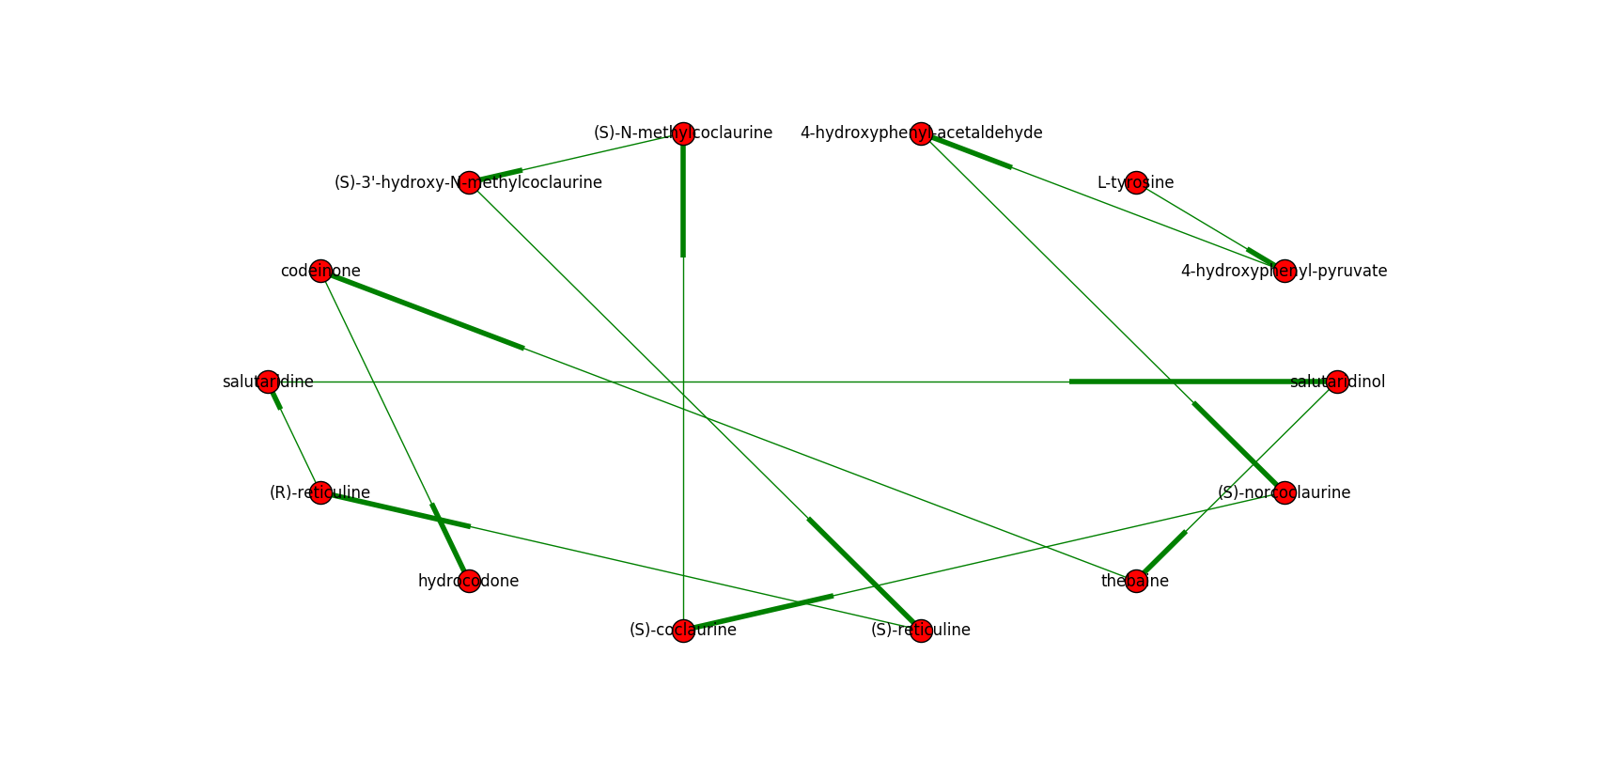
Small test sample:
Graph
Tables

Slide 10
Small Test: Continued

Slide 11
Example Text file:

Slide 12
Entering our network:
We included:

Slide 13
Running a simulation for N=# generations:
Results image, results per generation.

Slide 14
Results image as a slideshow format:

Slide 15
Modelling a deletion of (X) gene:

Slide 16
Modelling a nonfunctional (X) at N=#:
Results

Slide 17
Possible Improvements:
Add in more E. coli metabolic pathways which used (X) as a substrate to make the model more realistic
For example, integrate the model network into already developed E. coli networks which are available at (blah blah)
Allow for asynchronous updating, or kinetic parameter integration
Create own graph generator functions, which can handle self-directed edge visualization in graphs

Slide 18
Sources:
http://www.kyoto-u.ac.jp/en/research/research_results/2015/160205_1.html
http://onlinelibrary.wiley.com/doi/10.1002/biot.201600145/full

